Slide 1
Statistics

Slide 2
PREDICTIVE
Discriptive

Slide 3
Variable
Numeric
Categorical
Ordinal
Nominal
Continuous
Discrete

Slide 4
Data Types of variable
No_of_proj | avg_mon_hr | Time_spend | Work_accident | left | Promotion last 5 years | Dept | Salary
5 | 157 | 3 | 0 | 1 | 0 | Sales | Low
2 | 222 | 6 | 0 | 1 | 0 | Sales | Medium
6 | 160 | 4 | 0 | 1 | 0 | Sales | Medium
5 | 182 | 5 | 0 | 1 | 0 | RD | Low
Quantitative- Numerical Data Ex. No_of_proj
Qualitative-Non Numerical Data EX. Dept, Salary

Slide 5
Types of Quantitative Variable:
Continues- Ex. avg_mon_hr
Discrete – Ex. No_of_proj
No_of_proj | avg_mon_hr | Time_spend | Work_accident | left | Promotion last 5 years | Dept | Salary
5 | 157 | 3 | 0 | 1 | 0 | Sales | Low
2 | 222 | 6 | 0 | 1 | 0 | Sales | Medium
6 | 160 | 4 | 0 | 1 | 0 | Sales | Medium
5 | 182 | 5 | 0 | 1 | 0 | RD | Low

Slide 6
Qualitative Data: Categorical,Binary,Ordinal
Categorical – Ex. Dept(Sales,RD)
Binary- Ex. Left (0,1)
Ordinal – Ex. Sal(Low, Medium, High)
No_of_proj | avg_mon_hr | Time_spend | Work_accident | left | Promotion last 5 years | Dept | Salary
5 | 157 | 3 | 0 | 1 | 0 | Sales | Low
2 | 222 | 6 | 0 | 1 | 0 | Sales | Medium
6 | 160 | 4 | 0 | 1 | 0 | Sales | Medium
5 | 182 | 5 | 0 | 1 | 0 | RD | Low

Slide 7
Central Tendency
Central Tendency
Mean
Median
Mode

Slide 8
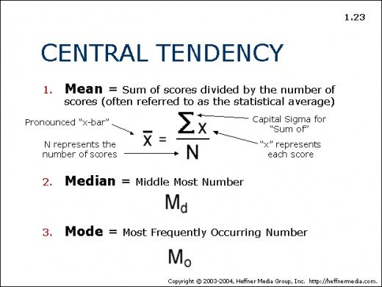

Slide 9
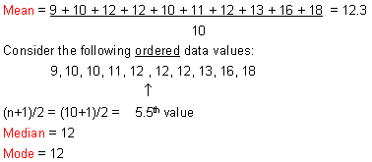
Example:
Consider the following data values:
9, 10, 12, 12, 10, 11, 12, 13, 16, 18.

Slide 10
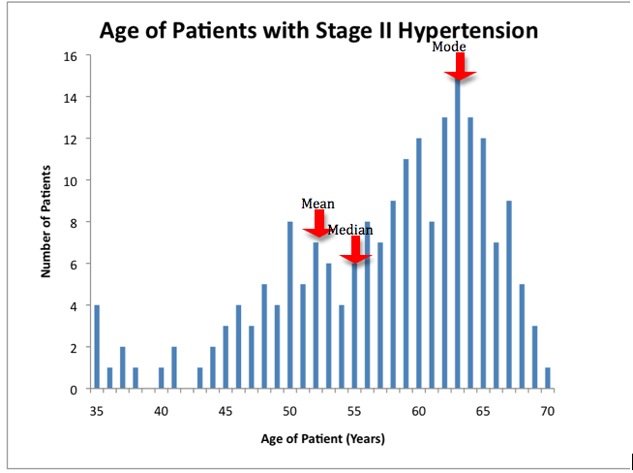

Slide 11
Terms in Statistics
Frequency
Variance
Standard Deviation
Range
Covariance
Correlation
Skewness

Slide 12
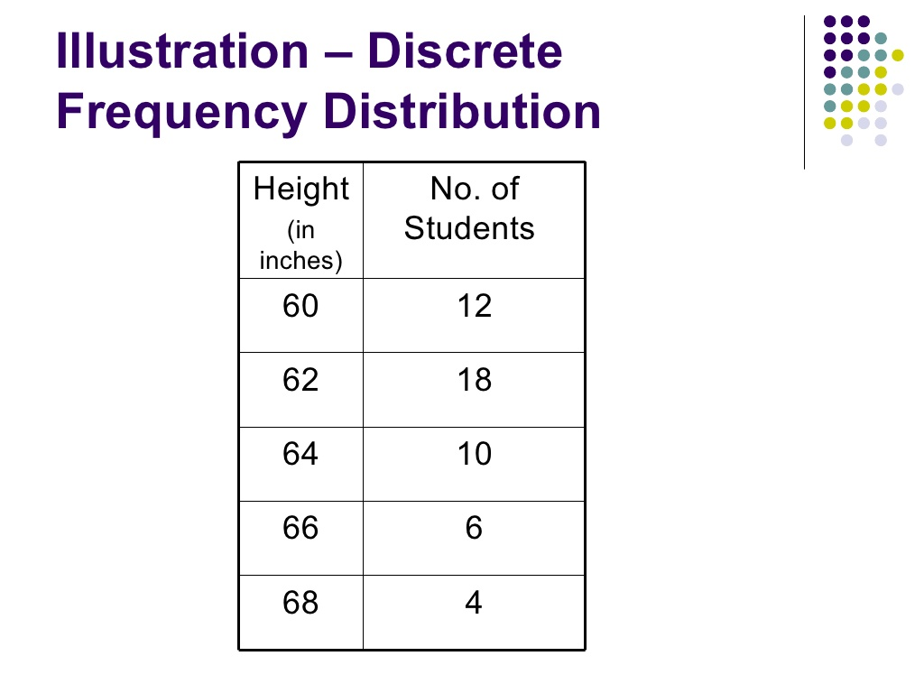

Slide 13
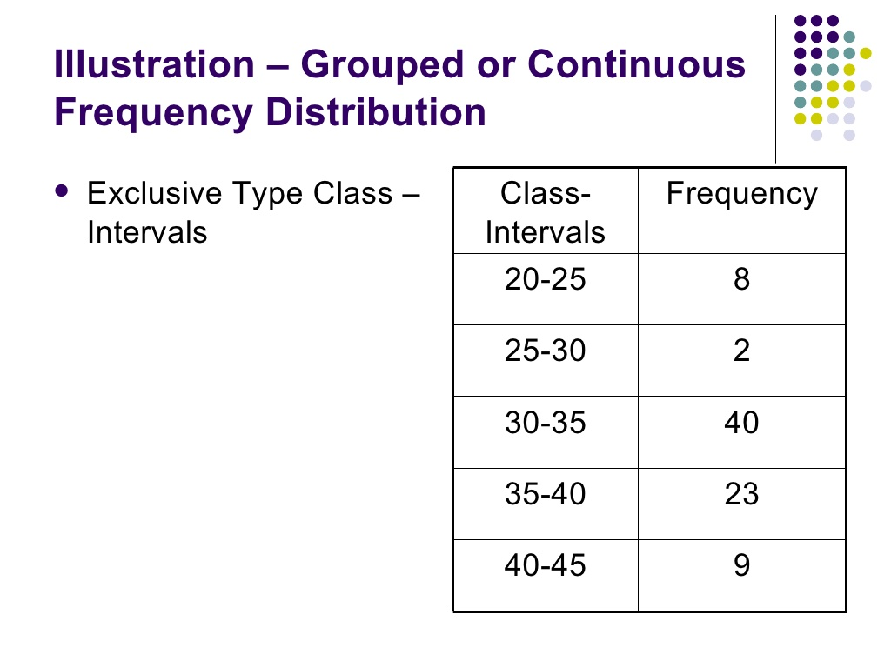

Slide 14
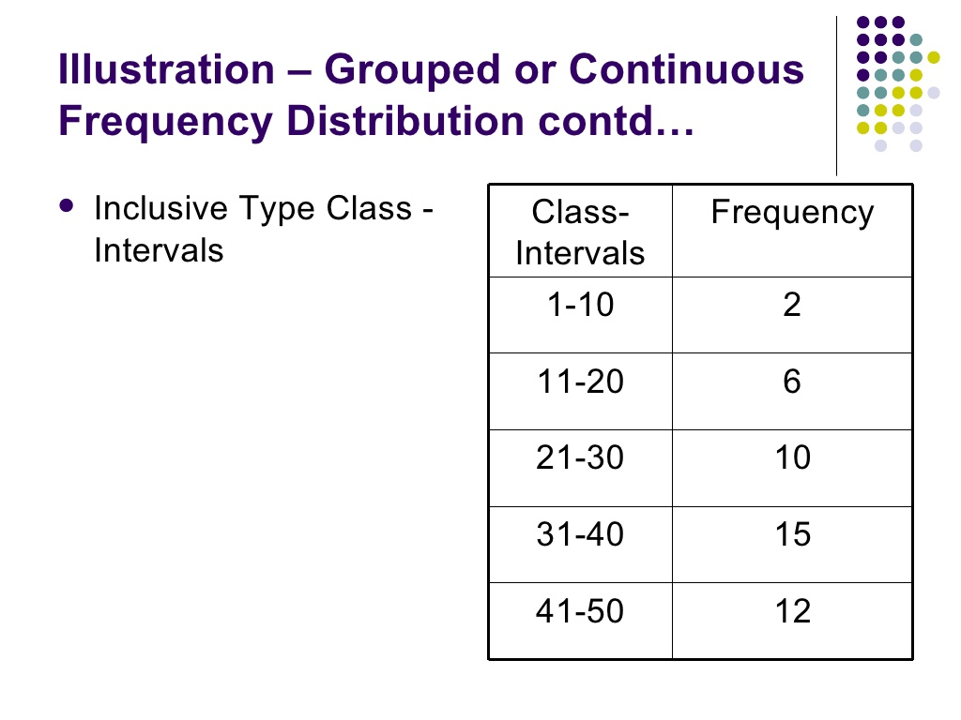

Slide 15
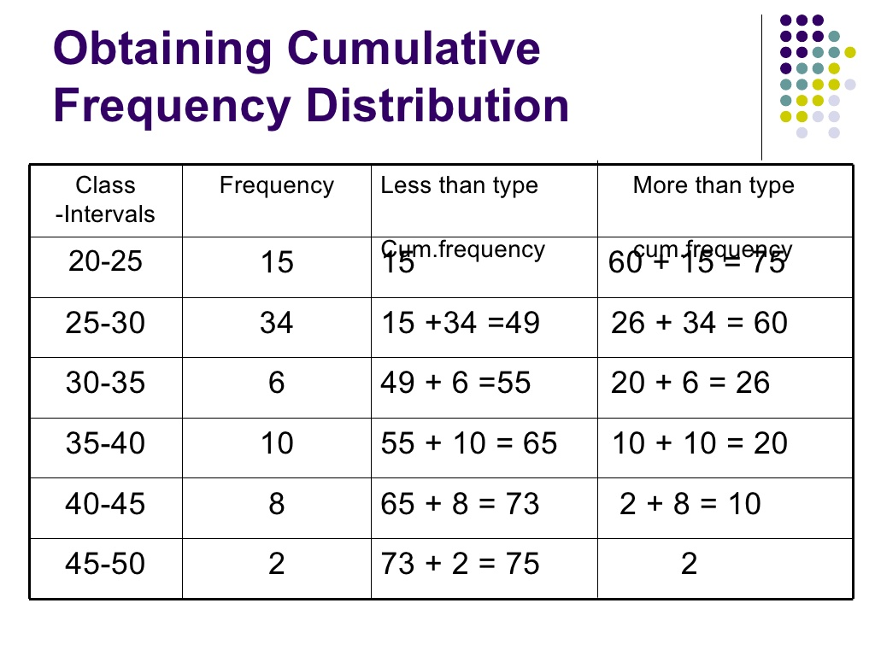

Slide 16
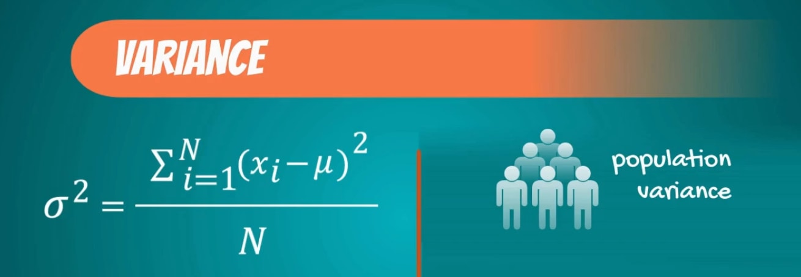
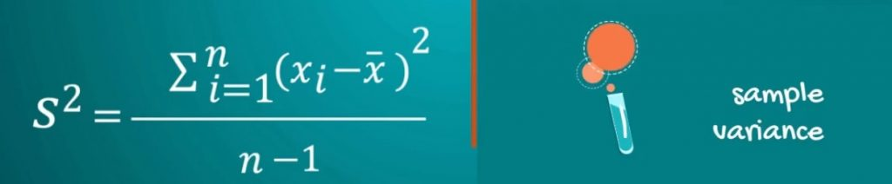

Slide 17

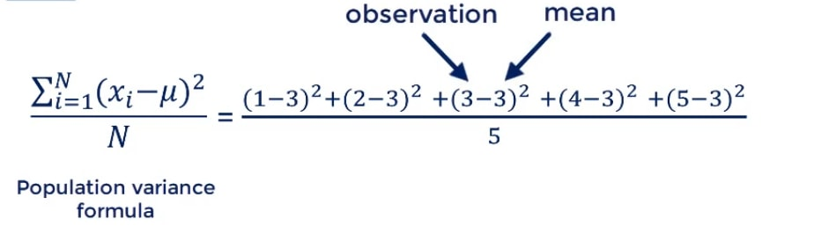
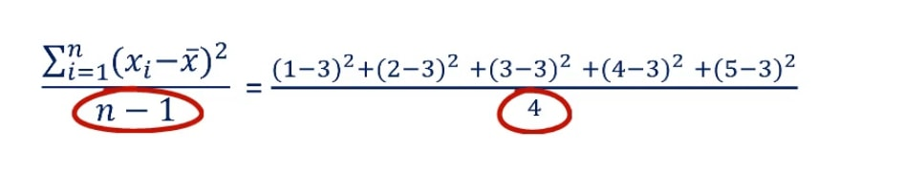
Example
1,2,3,4,5

Slide 18
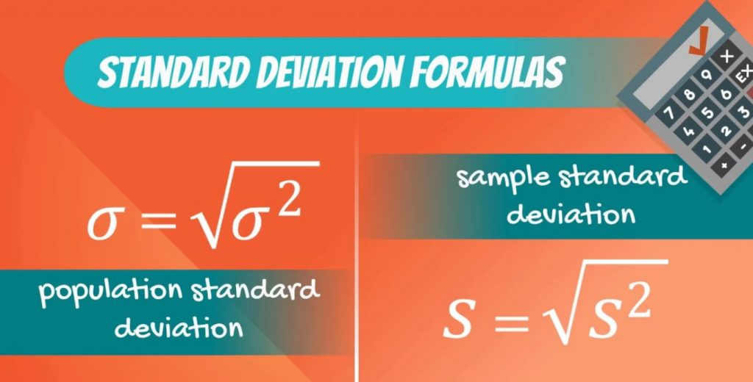

Slide 19
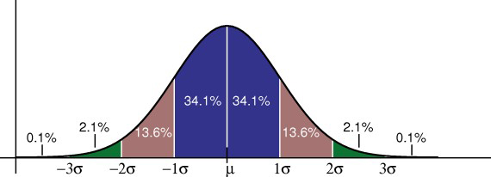

Slide 20
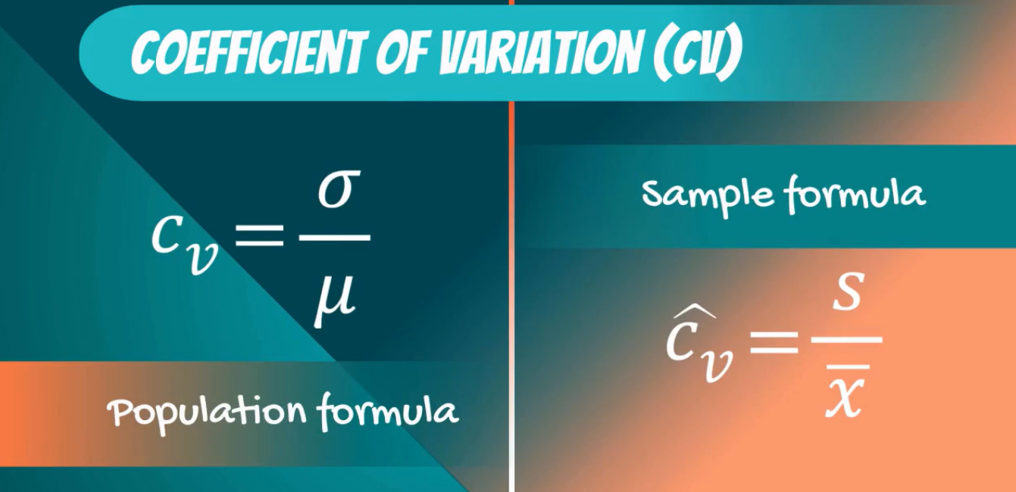
Standard Deviation and Coefficient of Variation- two different dataset

Slide 21
Standard Deviation and Coefficient of Variation

Slide 22
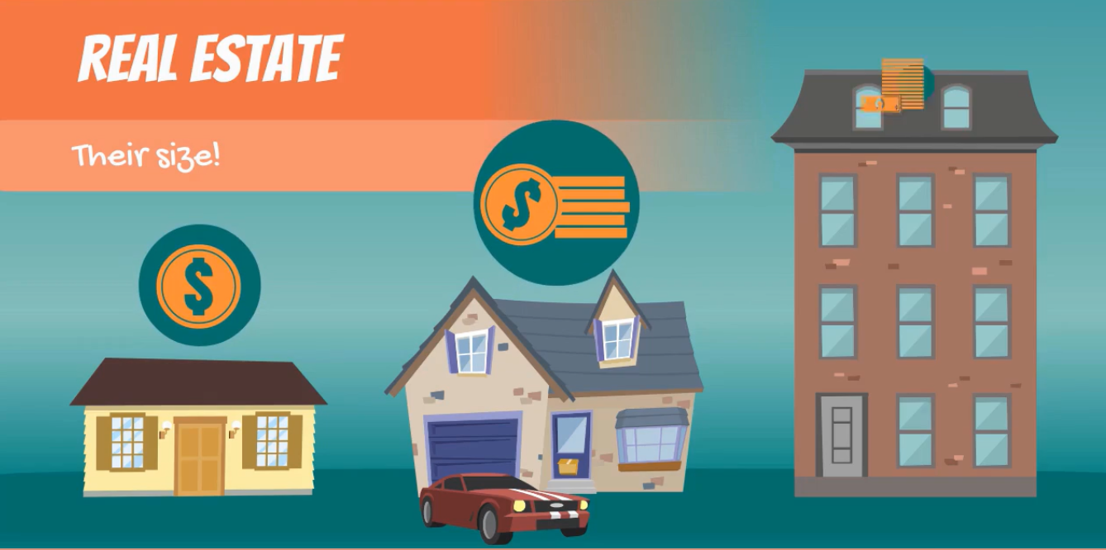
Covariance

Slide 23
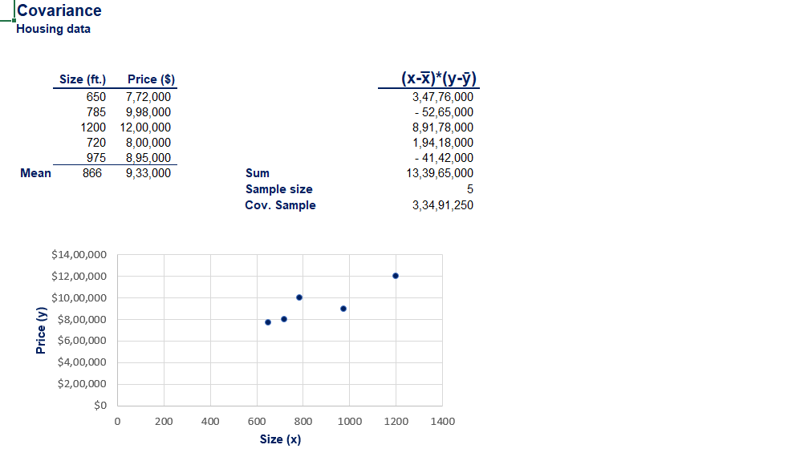
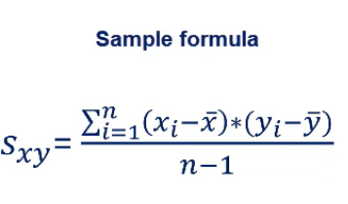
Covariance gives sense of direction
0> means two variable moving positive direction
0< means two variable moving negative direction
0=means two variable having no relation.

Slide 24
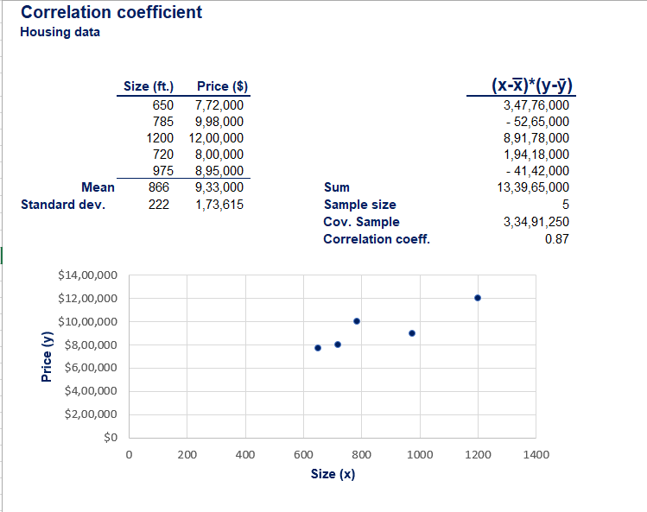
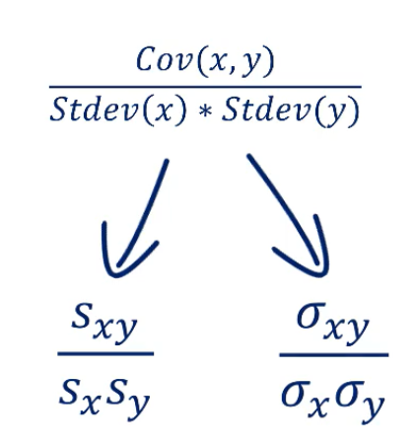
Correlation

Slide 25
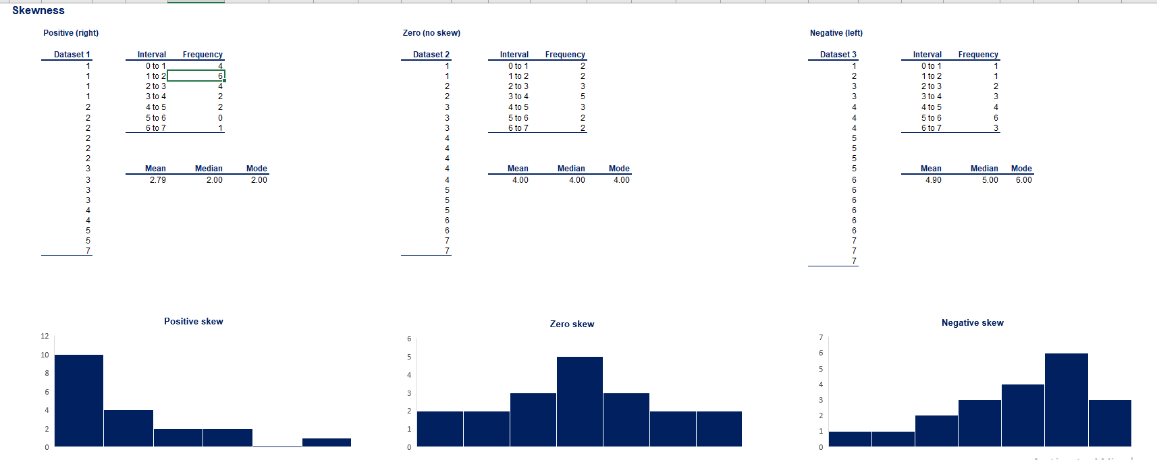
Skewness: Measure of Symmetry
Skewness indicates whether the data concentrate one side

Slide 26
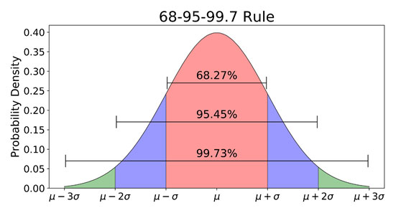
Empirical Rule
What is the Empirical Rule?
The empirical rule, also referred to as the three-sigma rule or 68-95-99.7 rule, is a statistical rule which states that for a normal distribution, almost all data falls within three standard deviations (denoted by σ) of the mean (denoted by µ). Broken down, the empirical rule shows that 68% falls within the first standard deviation (µ ± σ), 95% within the first two standard deviations (µ ± 2σ), and 99.7% within the first three standard deviations (µ ± 3σ)

